Slide 1



February 24, 2025
Town Council
STUDY SESSION

Slide 2

AGENDA
AGENDA
1 |
What We’ve Done
What We’ve Heard
What’s Next
2 |
3 |

Slide 3

WHAT WE’VE DONE

Slide 4
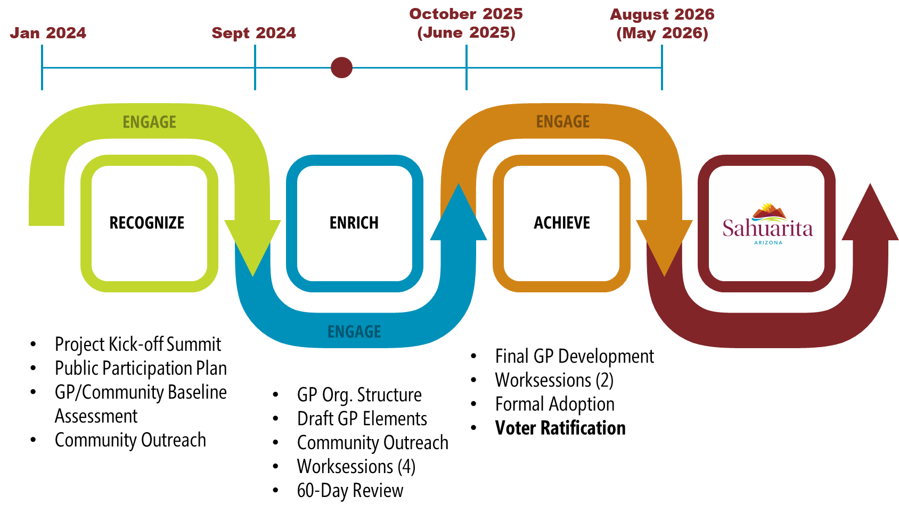
NEXT STEPS
WHERE ARE WE?

Slide 5
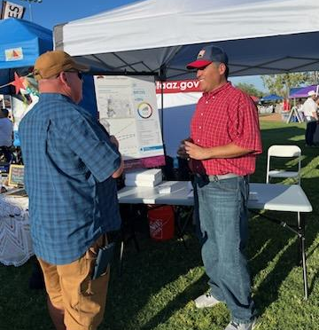
WHAT WE’VE DONE
OUTREACH TO DATE
1 |
Kickoff outreach at Stars & Stripes on July 4, 2024.
Community Workshop #1 was held Tuesday, July 23, 2024, in Council Chambers and had approximately 23 attendees.
Community Survey #1 was open July 23, 2024 through September 5, 2024, and garnered approximately 225 responses.
Staff participated in Element Review sessions in September and provided valuable feedback.
2 |
3 |
4 |

Slide 6
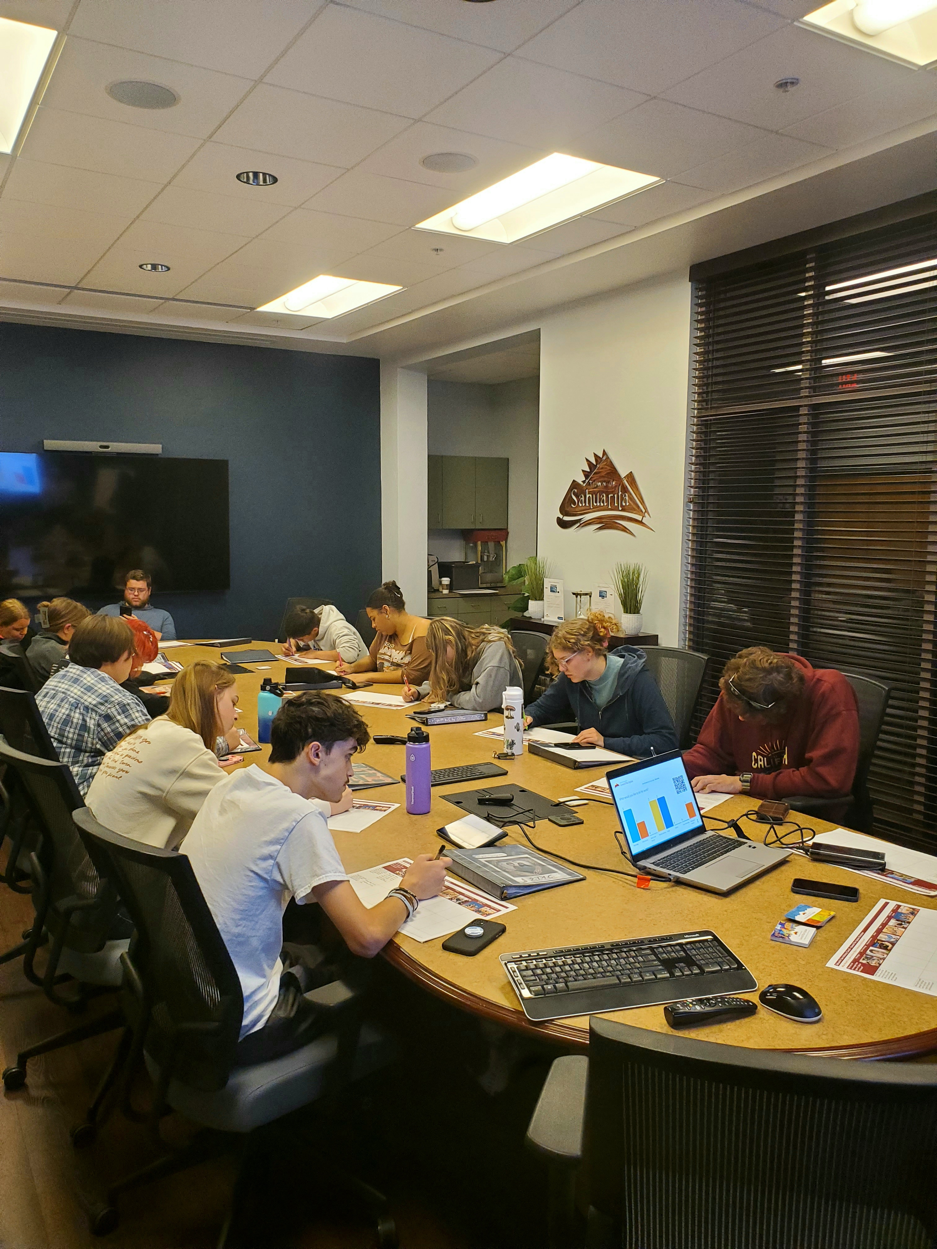
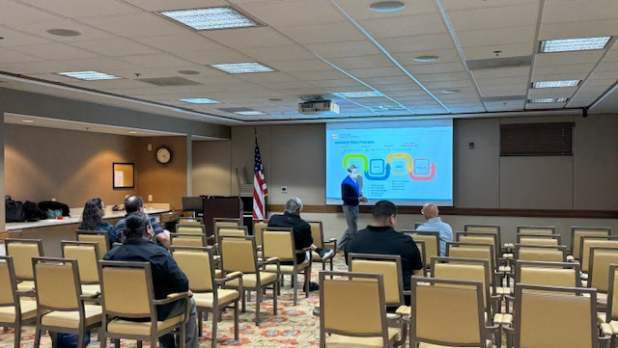
WHAT WE’VE DONE
OUTREACH TO DATE
5 |
Held a Study Session with Town Council on October 28, 2024.
Held a Study Session with Planning & Zoning Commission on November 4, 2024.
Held a youth workshop with the Sahuarita Teen Advisory Council on November 5, 2024.
Community Workshop #2 was held Tuesday, November 19, 2024, at La Posada and had 4 attendees.
6 |
7 |
8 |

Slide 7
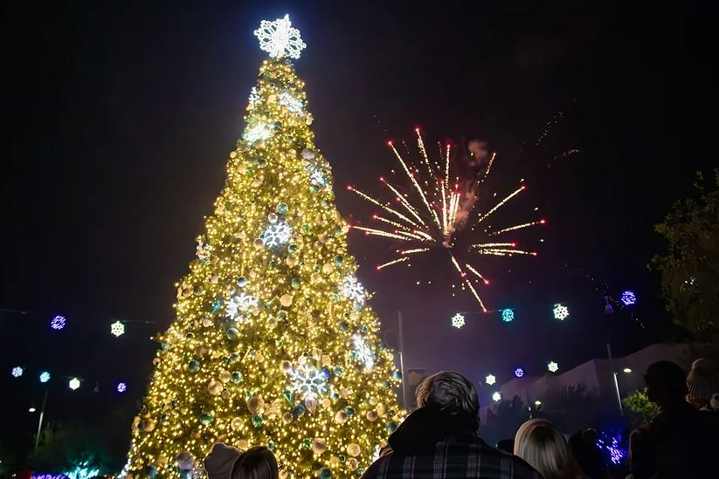
WHAT WE’VE DONE
OUTREACH TO DATE
8 |
Outreach at Winter Fest on December 7, 2024.
Community Survey #2 was open November 19, 2024 through January 8, 2025, and garnered approximately 224 responses across 5 distinct topical surveys.
9 |

Slide 8
WHAT WE’VE HEARD
WHAT WE DO WITH FEEDBACK
Michael Baker has reviewed the comments and feedback from Survey #1 & 2 and is continuing to work with staff to make necessary goal revisions based off public input, move and/or revise the policies that are used to implement the goals, and revise/update other aspects of the General Plan.
The revised/updated goals and policies, along with any other revisions that were made to the General Plan, will be released to the public for review as part of the 60-Day review process outlined in state statute.
1 |
2 |

Slide 9
WHAT WE’VE HEARD

Slide 10
WHAT WE’VE HEARD
WORKSHOP & SURVEY #1 REFRESHER
1 |
Seek input on residents' overall perception of Sahuarita across multiple subject areas
Seek input on the existing Vision Statement
Seek input on the existing Goals and whether they are still appropriate for Sahuarita
2 |
3 |

Slide 11

HEADING TITLE
WORKSHOP & SURVEY #2
(REVISED VISION & GOAL REVIEW)

Slide 12
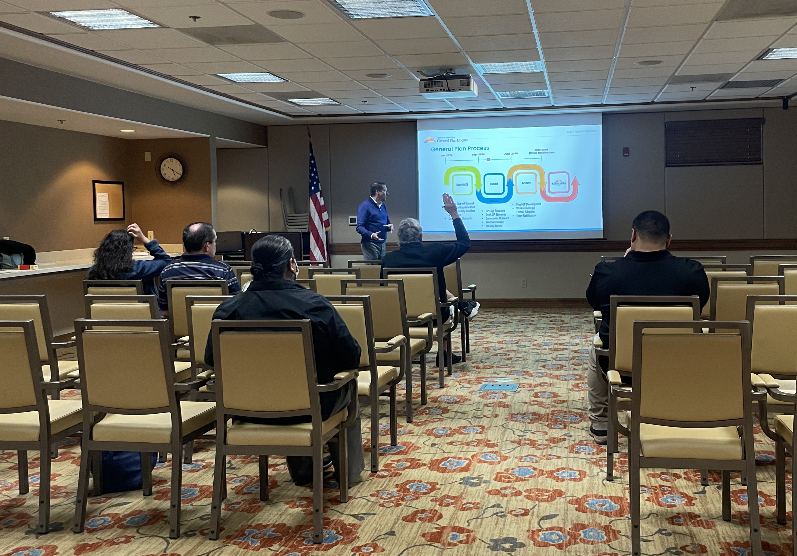
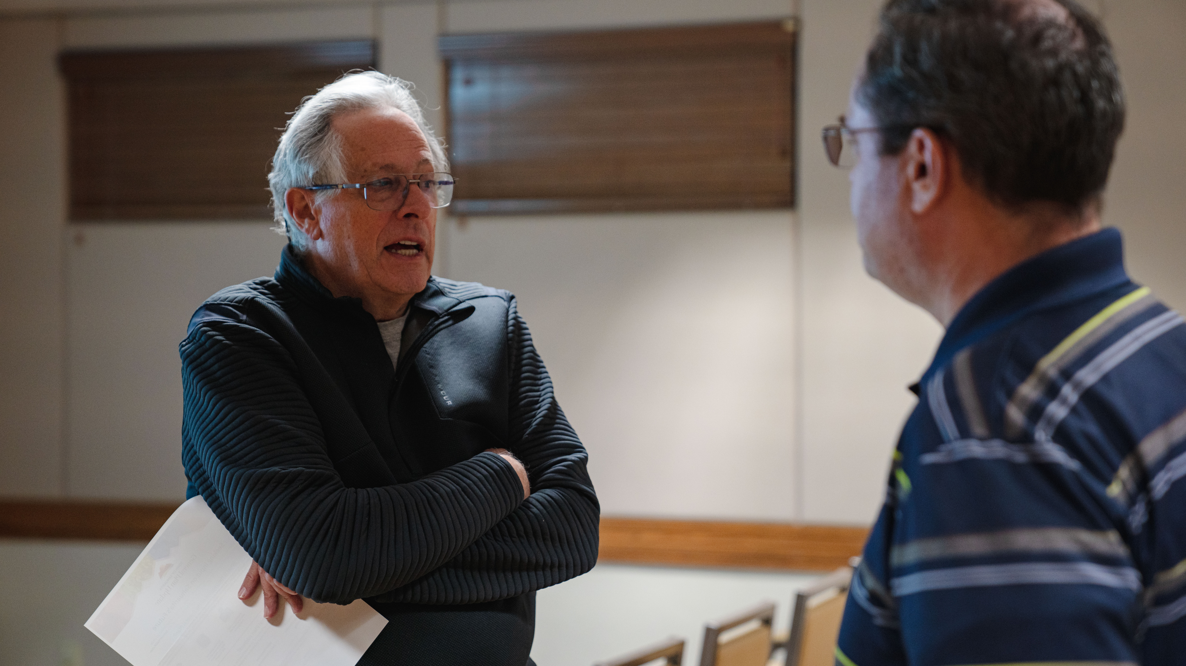
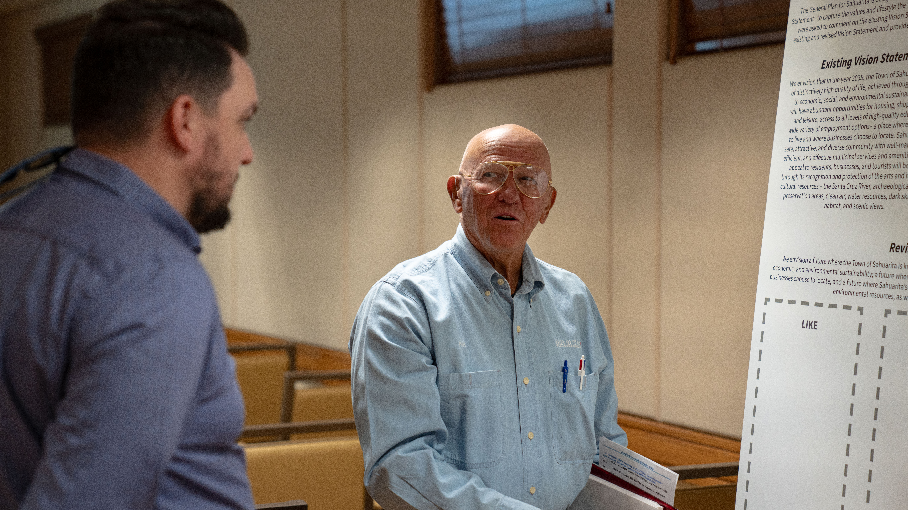
WHAT WE’VE HEARD
WORKSHOP & COMMUNITY SURVEY #2
1 |
Community Workshop #2 was held Tuesday, November 19, 2024, at La Posada and had 4 attendees.
Community Survey #2 was open through January 8, 2025, and garnered approximately 224 survey responses across 5 distinct topical surveys.
Overall, the revised goals received positive feedback. Each goal had a majority of respondents agree that the goal will help implement the long-range vision for Sahuarita.
2 |
3 |

Slide 13
WHAT WE’VE DONE
REVISED VISION STATEMENT
“We envision a future where the Town of Sahuarita is known as a community with a high quality of life driven by its commitment to social, economic, and environmental sustainability; a future where Sahuarita is an attractive and diverse community in which people choose to live and businesses choose to locate; and a future where Sahuarita’s appeal is enhanced through the recognition and protection of its cultural, historic, and environmental resources, as well as its natural open space, dark skies and scenic views.”

Slide 14
SURVEY RESULTS
REVISED VISION STATEMENT COMMENTS
The revised Vision Statement generally received positive feedback with comments noting additional ideas respondents would like to see incorporated, and mixed opinions about specific topics. Comments included:
PUBLIC COMMENTS
COMMISSION FEEDBACK
Need to include educational system and public safety in the vision.
Mixed opinions on the importance of cultural, historic, and environmental protection, as well as sustainability.
Need to include additional language about visitors & tourism
Education should be supported in the General Plan; however, it may not rise to the vision as the Town does not control the educational system
The Town should support VIABLE opportunities for cultural, historic, environmental protections
The Town should provide amenities for visitors although it may not need to be part of identity as it is in other communities in Arizona.
1 |
2 |
3 |

Slide 15
SURVEY RESULTS
REVISED TRANSPORTATION &
PUBLIC FACILITIES AND SERVICES GOALS
PUBLIC COMMENTS
COMMISSION FEEDBACK
Need to balance of future amenities across all neighborhoods and not just within the specific plan zoned neighborhoods.
Need for better access, more traffic signals and additional capacity as the town continues to grow.
There may be a need to consider complementing some of the private amenities that exist for residents in HOAs by offering them as public amenities across town (i.e., pool, pickleball, etc.)
In addition to having good transportation policies, having wise growth policies will also help ensure that new development does not have a negative impact on the existing infrastructure
1 |
2 |

Slide 16
SURVEY RESULTS
REVISED PARKS, RECREATION & OPEN SPACE GOALS
PUBLIC COMMENTS
COMMISSION FEEDBACK
The need to preserve the natural desert for recreation and ecological balance is a priority.
Providing activities for all age levels is a priority
Look to other municipalities in the region for ideas.
It is important to have a balance of amenities and program offerings for all age groups and while looking to other areas for ideas is a good place to start the needs of the Town also need to be kept at the forefront.
1 |
2 |
3 |

Slide 17
SURVEY RESULTS
REVISED ENVIRONMENTAL, WATER RESOURCES, & ENERGY GOALS
PUBLIC COMMENTS
COMMISSION FEEDBACK
1 |
The need to preserve the natural desert and ecological balance is a must
Questions about how some of the goals will be implemented
Ideas for the implementation of some of the goals
Encouraging the protection of our natural systems (i.e., preservation of natural wash corridors over concrete lined channels) is important and the approach the Town is currently taking in this area is good. However, while they agree it is important it may not rise to a priority in all areas.
2 |
3 |

Slide 18
SURVEY RESULTS
REVISED LAND USE & GROWTH AREAS GOALS
PUBLIC COMMENTS
COMMISSION FEEDBACK
There is a desire to maintain the small-town feel but also a strong desire to attract large retail establishments such as Home Depot, Target & Costco, additional restaurants and more healthcare services.
There are mixed opinions on the development of multi-family housing.
The “small-town” notion is good, but we really need to confirm, “What does ‘small town’ mean to you?” A good place to start to maintain that feel would be to keep focus on social connectivity and not just mobility connectivity
The desire to attract more and larger retail establishments is a common priority amongst residents. However, it should be noted that we need more roof tops to attract these types of establishments.
While some residents may not like the idea of MF, what they really don’t like is being surprised, so having a defined plan will help.
1 |
2 |

Slide 19
SURVEY RESULTS
REVISED ECONOMIC DEVELOPMENT & COST OF DEVELOPMENT GOALS
PUBLIC COMMENTS
COMMISSION FEEDBACK
1 |
Creating partnerships with U of A / Pima Community College to get a highly educated labor force that is home grown.
Skepticism on whether the goals are feasible
It was suggested that any revisions to the goals or policies generally note education institutions rather than calling out specific schools by name. Additional detail could be included to meet with specific schools as an action item.
2 |

Slide 20
POLICY DISCUSSION
COMMON THEMES ACROSS BOTH SURVEYS
1 |
Education and safety should continue to be a priority in the town and in the General Plan
There is a lack of high-paying jobs and business opportunities outside of retail and fast food. Residents expressed a desire for more diverse businesses, such as technology centers and manufacturing, to provide better employment opportunities.
Goal: Support partnerships and collaborations focused on quality education and facilities.
Description: The Town will continue to work with school districts and other partners to ensure that residents have opportunities for high-quality education and lifelong learning in the community.
Policy: Work with the Town’s major developers and local industry to identify the potential of developing appropriate areas for signature office buildings, flex space, and high-tech industry.
2 |

Slide 21
POLICY DISCUSSION
COMMON THEMES ACROSS BOTH SURVEYS
The town lacks sufficient recreational activities and amenities, especially for older adults and families with young children. There is a call for more community events, cultural activities, and facilities like parks, sports fields, and a recreation center.
Policy: Provide a range of recreational, educational, enrichment, and special interest programs and events to meet the diverse interests, ages, and needs of residents throughout Sahuarita.
3 |

Slide 22
WHAT’S NEXT

Slide 23
NEXT STEPS
WHERE ARE WE?

Slide 24
NEXT STEPS
FUTURE OUTREACH
Seeking input on the following ideas for future outreach:
Hold separate Community Workshop #3 & survey outreach at special events
Combine the Community Workshop #3 with the survey outreach at special events
The 60-Day review period required by state statute will begin Fall 2025.
Michael Baker & Staff will conduct outreach during the 60-day review window to gather feedback on the draft General Plan.
1 |
2 |
3 |

Slide 25
THANK YOU!

Slide 26
WHAT WE’VE HEARD
EXISTING VISION STATEMENT
“We envision that in the year 2035, the Town of Sahuarita will be a place of distinctively high quality of life, achieved through its commitment to economic, social, and environmental sustainability. Sahuarita will have abundant opportunities for housing, shopping, recreation and leisure, access to all levels of high-quality education, and a wide variety of employment options– a place where people choose to live and where businesses choose to locate. Sahuarita will be a safe, attractive, and diverse community with well-maintained, highly efficient, and effective municipal services and amenities. Sahuarita’s appeal to residents, businesses, and tourists will be enhanced through its recognition and protection of the arts and its natural and cultural resources – the Santa Cruz River, archaeological and historic preservation areas, clean air, water resources, dark skies, natural habitat, and scenic views.”

Slide 27
WHAT WE’VE DONE
EASIER UNDERSTANDING & INCREASED USABILITY/ INCORPORATION OF FEEDBACK
TRN-1: Provide an effective, convenient, accessible, safe and economically sustainable transportation network that offers choices of routes and modes of travel to all land uses, services and destinations.
First Survey Public Comments:
Roads need to be maintained and expanded
More traffic control including the need for intersections to be signalized or have better signalization
TRN-1: Provide an efficient, reliable, accessible, and safe multi-modal transportation system.
Description: An effective transportation system is comprised of a network of streets each with its own designation, function, and capacity within the system. Each segment contributes to the interconnectivity of the system. Therefore, for a system to operate efficiently, it is essential for there to be a well-connected and functional street network that is easy to access and navigate, reliable, safe, cost-effective and in harmony with adjacent land uses.

Slide 28
WHAT WE’VE DONE
REDUCE REDUNDANCY
The project team reviewed all goals for overlap, duplication and efficiency. As part of this process some goals were combined or removed.
GA-3: Develop funding methods to proportionately distribute infrastructure costs associated with new development.
=
CD-2: Ensure that new growth and development pays its proportionate share toward the cost of public service needs generated by new development, with appropriate exceptions when in the public interest.
CD-2: Ensure that new growth and development pays its proportionate share toward the cost of public service needs generated, with appropriate exceptions when in the public interest.

